Slide 1


SMART GLASS 2.0

Slide 2

Team Details
College Name : Indus University Ahmedabad
Mentor : Sejal Thakkar
By Yashas Majmudar
Saumya Ramolia
Ritika Dhall
Khushi Manek
Frenil Patel
Team Leader Email: yashashm@gmail.com

Slide 3

PROBLEM STATEMENT & ITS OBJECTIVE
Enhance on road travel experience which focuses on:
Preventing accidents
Time management
​​Cost efficiency
This Photo by Unknown Author is licensed under CC BY-NC-ND

Slide 4

INTRODUCTION ON PROBLEM STATEMENT
70% road accidents occur due to drivers using their cell phones while driving.
Cell phones offer several features, useful and distracting, that require the driver to take his eyes off the road.
Notifications are a major source of distraction while driving. With the increasing influence of social media and messaging services, checking notifications has become hard to resist.
GPS technology, while useful, can also have a harmful effect. With the advent of GPS technology, there has been an increase in the number of people relying on it to reach their destination, but more often than not users are compelled to take their eyes off the road and check their GPS systems.

Slide 5

TECHNICAL ASPECTS OF SMART GLASS
ANDROID APP
Bluetooth
Arduino
Display

Slide 6
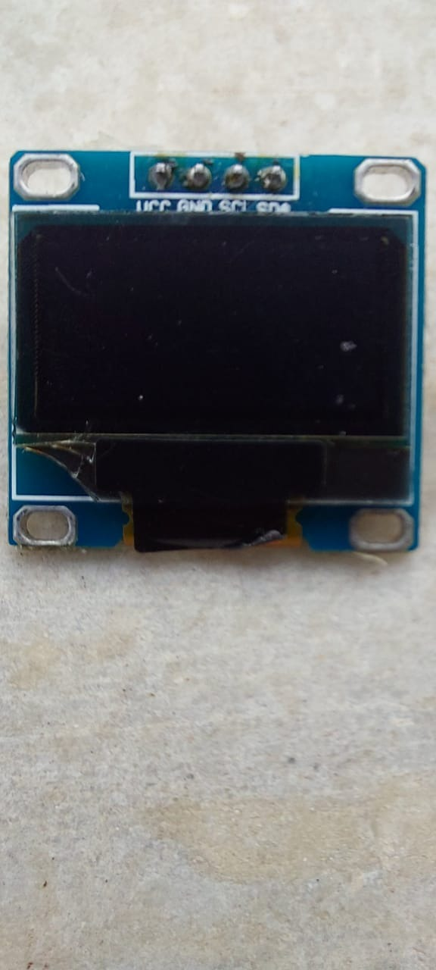
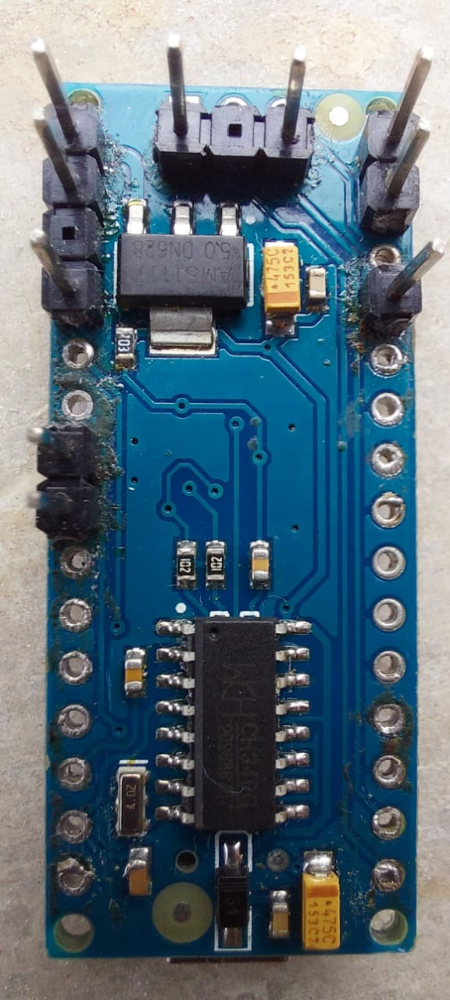
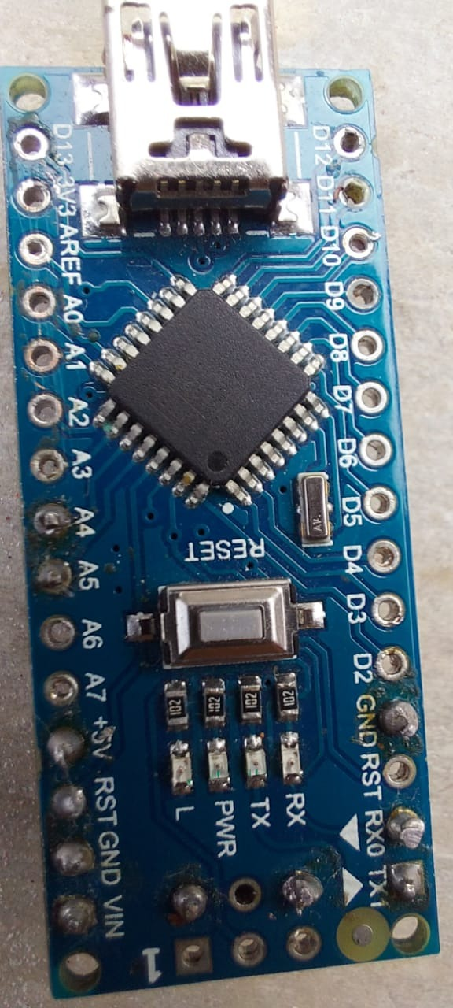
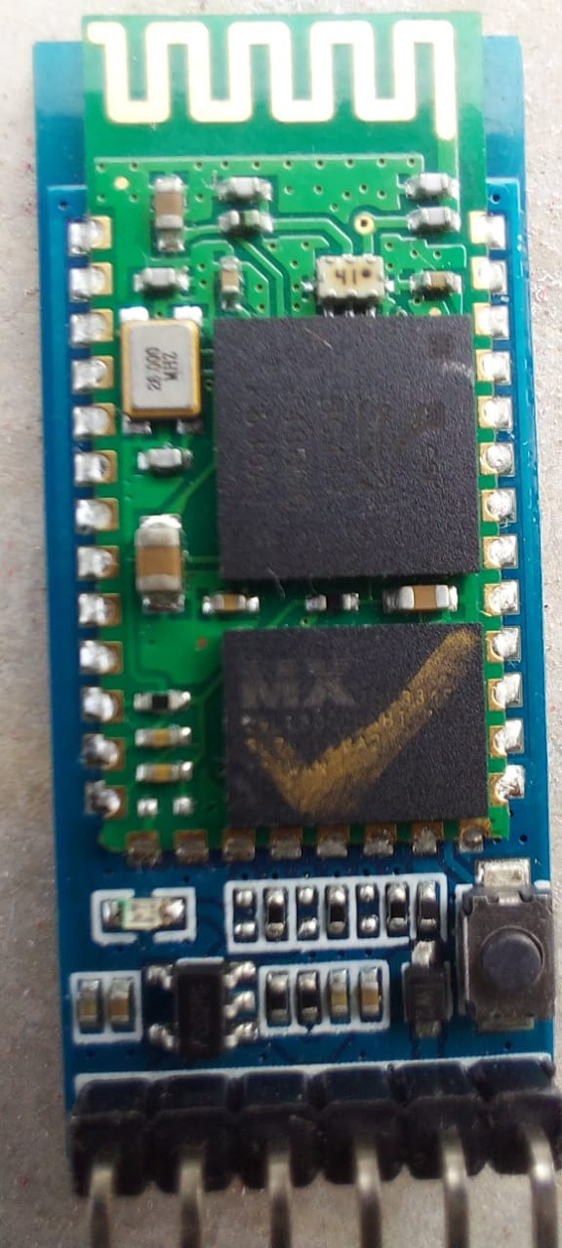

Slide 7
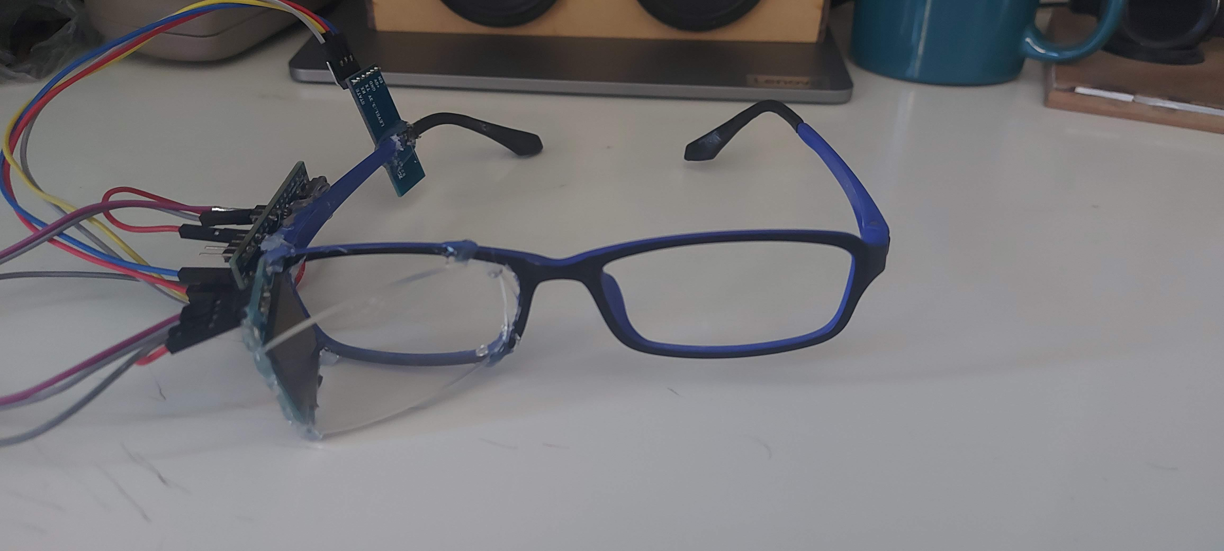
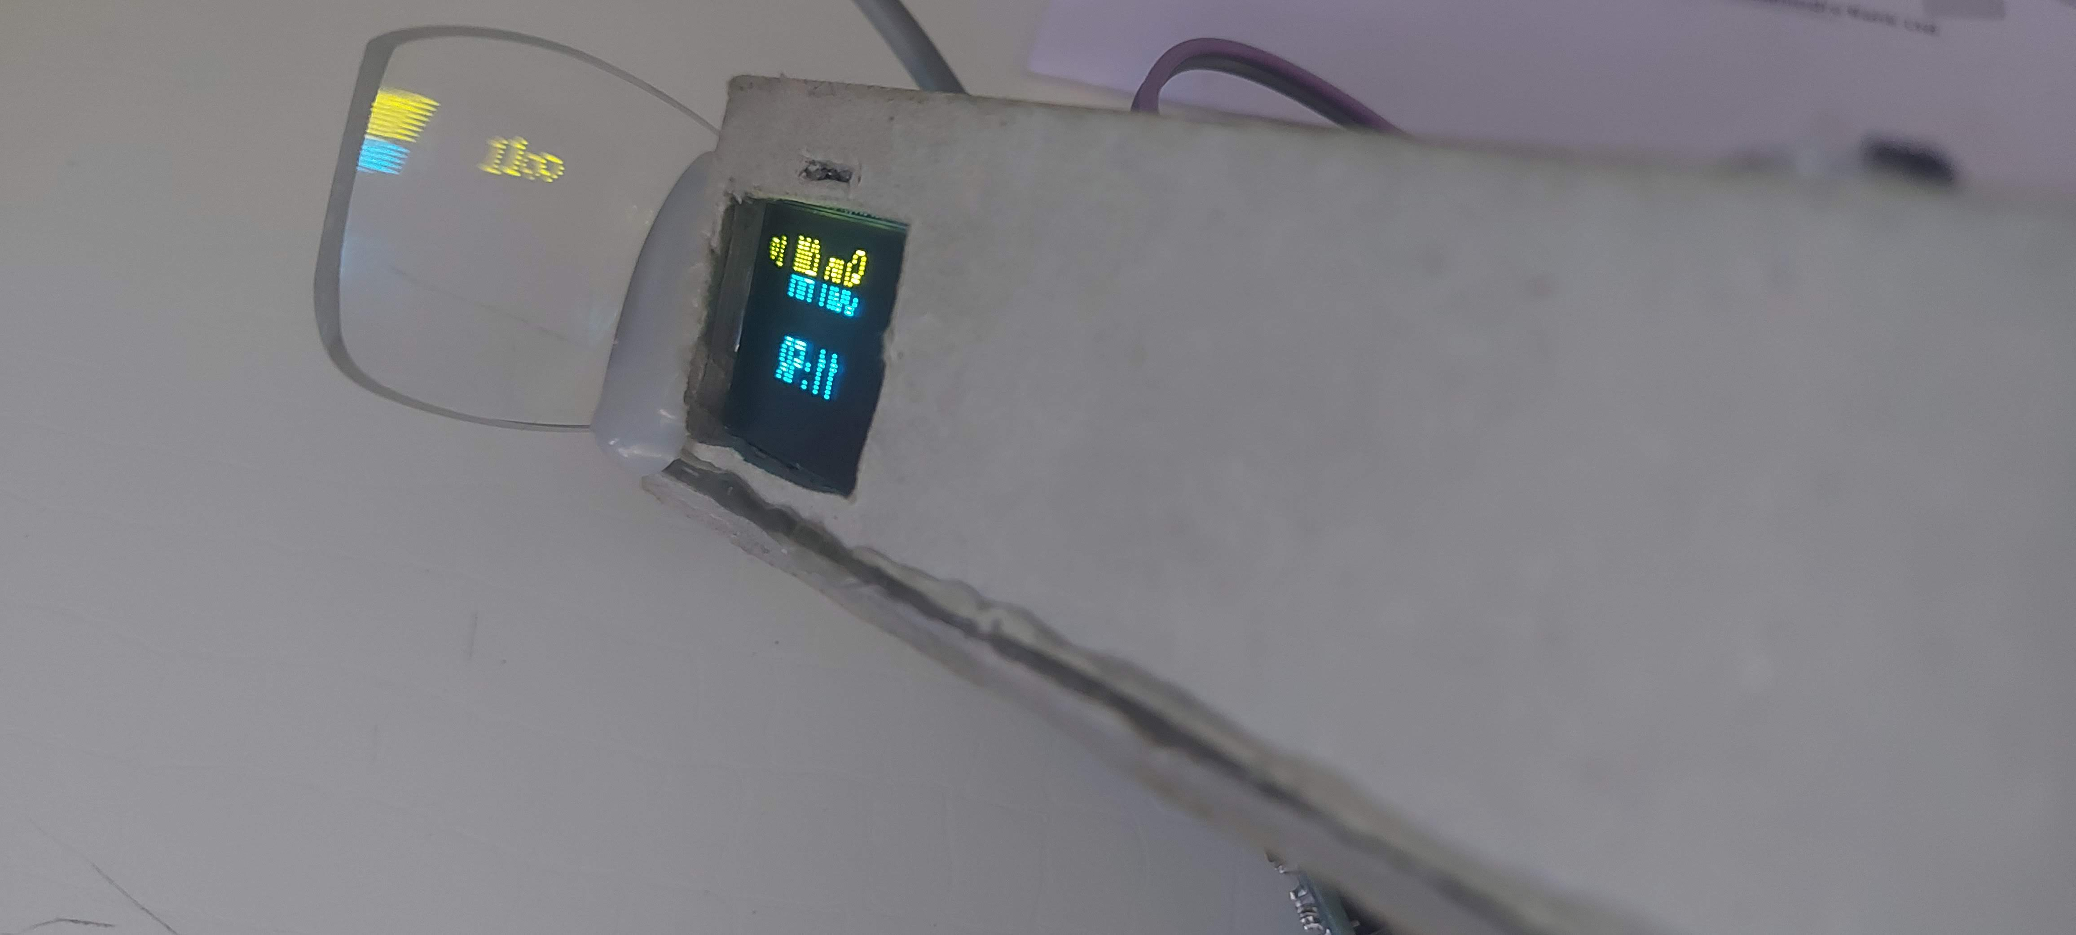
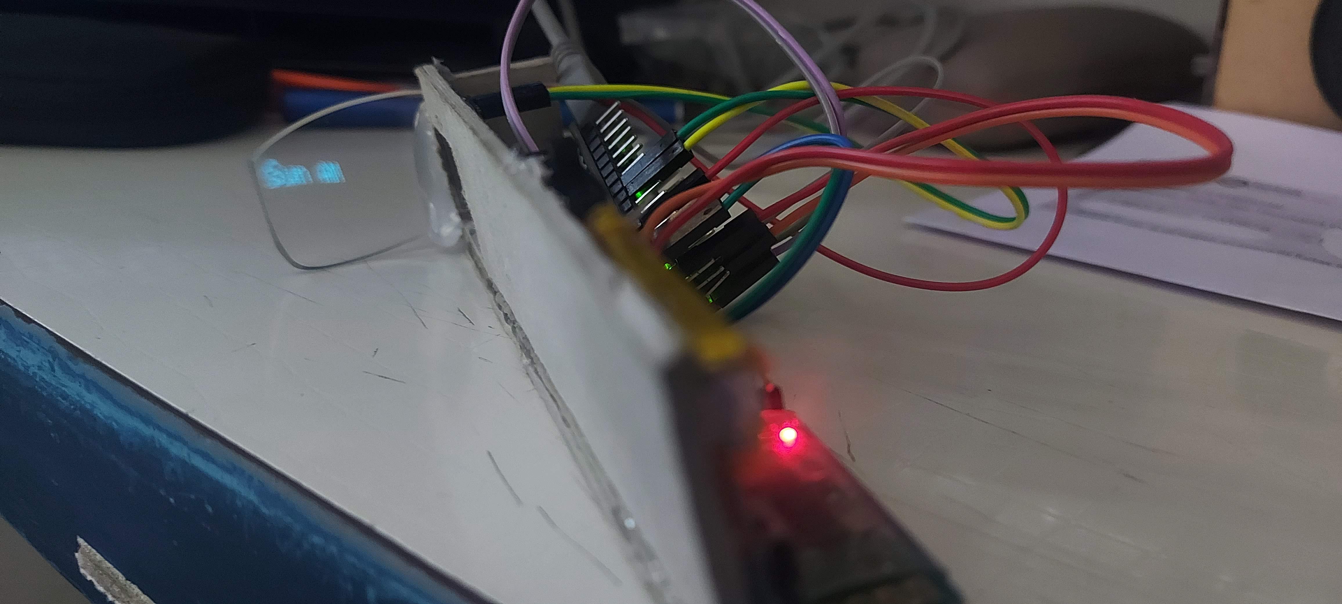
Images of Smartglass

Slide 8
Cost of Smart Glass
Usually, a smart glass or spectacle costs a lot but the solution we produced is inspired from the same idea but is on the cost-effective side. The total cost of the device including Arduino, Batteries, circuits and display comes up to as low as ₹4,000 or $54.35. The app used to run the device from mobile application is taken from an open source project and is free for any android platform.

Slide 9

RESULT
The device provides real time updates about notifications like whatsapp, instagram, message, snapchat etc. Even shows if user is receiving a call. After more development and research on the project we will be able to show navigation details.

Slide 10

Outcome /benefit of the Smart Glass
The user doesn't have to look through their phone
Increases concentration while driving or riding vehicles
Other advantages are that it can be modified to provide real time updates to military personnel or medical personnel about necessary information.

Slide 11
Future Advancements
More sophisticated circuits
Projector instead of oled
Android integration
Camera for AR
Bone conduction headsets

Slide 12

References
Adafruit Libraries
RetroWatch
Arduino

